Slide 1

A comparative study between One-way ANOVA and Kruskal-Wallis test for testing equality of several group means when the underlying population distributions are continuous
Name: Adrija Bhar
Roll No: 416
Registration No: A01-2142-0842-20
Semester: 6
Supervisor: Prof. Pallabi Ghosh
Department of Statistics
St. Xavier’s College (Autonomous)
Kolkata

Slide 2
ABSTRACT
We will use simulations to compare between parametric test ANOVA and nonparametric test Kruskal-Wallis test in terms of power in multiple sample comparison problem related to equality of mean of the three independent groups. Also, we will try to investigate the effects of violations of those assumptions(i.e., normality and homoscedasticity) on the power of the ANOVA and Kruskal-Wallis test under various scenarios.
We have studied the empirical powers under different continuous population distributions for e.g., Normal and Non-normal distribution. And under Non-normal we have chosen two symmetric and two asymmetric distributions for our study. The chosen continuous population distributions are:
Underlying Population Distribution
Normal
Non-normal
Normal Distribution
Symmetric
Asymmetric
Laplace Distribution
Logistic Distribution
Lognormal Distribution
Exponential Distribution

Slide 3

Multiple Sample Hypothesis Problem
It is basically hypothesis testing problem regarding more than two populations or population distributions. And the important thing is that here the populations under study are independent. In such hypothesis problems we may be interested in tests related to mean, median, location parameter, scale parameter etc.
K independent populations (K>2)
Population
X₁
Population
X₂
Population
X₃
… …
Population
X_{K}
Test for Equality
of Mean
To test $H_{0}$: $μ_{1}=μ_{2}=μ_{3}= …=μ_{K}$

Slide 4
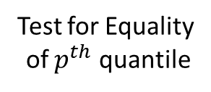

Multiple Sample Hypothesis Problem
It is basically hypothesis testing problem regarding more than two populations or population distributions. And the important thing is that here the populations under study are independent. In such hypothesis problems we may be interested in tests related to mean, median, location parameter, scale parameter etc.
K independent populations (K>2)
Population
X₁
Population
X₂
Population
X₃
… …
Population
X_{K}
To test $H_{0}$:$ξ_{p}^{\left(1\right)}=ξ_{p}^{\left(2\right)}=ξ_{p}^{\left(3\right)}= …=ξ_{p}^{\left(K\right)}$
Test for Equality
of $p^{th}$ quantile

Slide 5

Statistical Inference
Conclude about unknown or partly unknown
“Target population”
Inductive
process
From a
known sample
Statistical Inference
Parametric Inference
Non - Parametric Inference

Slide 6
Parametric Inference
Area of statistical inference
Assumes sample comes from population adequately modelled by some well-known population distribution
Those population distributions can be characterized by a fixed set of constant parameters

Slide 7
Non - Parametric Inference
Area of statistical inference
Based on either being “distribution-free” or having a specified distribution
Those specified distributions can’t be characterized by a finite number of parameters

Slide 8

Hypothesis Problem of Our interest
In this study we have considered the hypothesis test for equality of means of three independent populations.
Under parametric setup
Under nonparametric setup

Slide 9


Hypothesis Problem of Our interest in general
3 independent populations
Population
X₁
Population
X₂
Population
X₃
To test $H_{0}$: $μ_{1}=μ_{2}=μ_{3}$
Test for Equality
of Mean
Against
To test $H_{0}$: $μ_{1}<μ_{2}<μ_{3}$
Chosen Alternative Hypothesis
And we want to test this hypothesis, when the population distributions of all populations X₁, X₂, X₃ are Normal, Laplace, Logistic, Lognormal and Exponential distribution separately.

Slide 10

PARAMETRIC SETUP

Slide 11
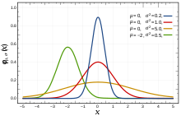



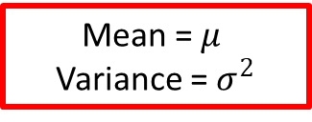

Hypothesis Problem under Parametric setup
Underlying Population distributions are Normal:
Independent populations
$$\text{X}\text{3} \sim Normal(μ_{3},σ_{3}^{2})$$
$$\text{X}\text{2} \sim Normal(μ_{2},σ_{2}^{2})$$
X₁$\sim Normal(μ_{1},σ_{1}^{2})$
Mean = $μ$
Variance = $σ^{2}$
Population
X₁
Population
X₂
Population
X₃
Mean is Location Parameter
To test $H_{0}$: $μ_{1}=μ_{2}=μ_{3}$
Test for Equality
of Mean
Against
To test $H_{0}$: $μ_{1}<μ_{2}<μ_{3}$
Chosen Alternative Hypothesis

Slide 12
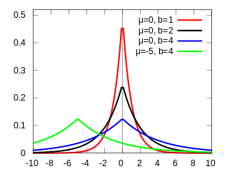





Hypothesis Problem under Parametric setup
Underlying Population distributions are Laplace:
Independent populations
$$\text{X}\text{3} \sim Laplace(μ_{3},σ_{3})$$
$$\text{X}\text{2} \sim Laplce(μ_{2},σ_{2})$$
X₁$\sim Laplace(μ_{1},σ_{1})$
Mean = $μ$
Variance = 2$σ^{2}$
Population
X₁
Population
X₂
Population
X₃
Mean is Location Parameter
To test $H_{0}$: $μ_{1}=μ_{2}=μ_{3}$
Test for Equality
of Mean
Against
Chosen Alternative Hypothesis
To test $H_{0}$: $μ_{1}<μ_{2}<μ_{3}$

Slide 13
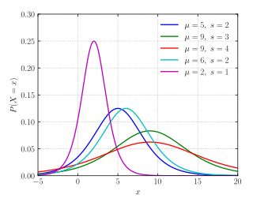



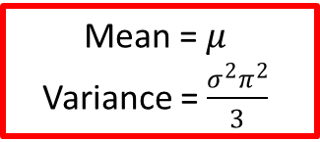

Hypothesis Problem under Parametric setup
Underlying Population distributions are Logistic:
Independent populations
$$\text{X}\text{3} \sim Logistic(μ_{3},σ_{3})$$
$$\text{X}\text{2} \sim Logistic(μ_{2},σ_{2})$$
X₁$\sim Logistic(μ_{1},σ_{1})$
Mean = $μ$
Variance = $\frac{σ^{2}π^{2}}{3}$
Population
X₁
Population
X₂
Population
X₃
Mean is Location Parameter
To test $H_{0}$: $μ_{1}=μ_{2}=μ_{3}$
Test for Equality
of Mean
Against
To test $H_{0}$: $μ_{1}<μ_{2}<μ_{3}$
Chosen Alternative Hypothesis

Slide 14
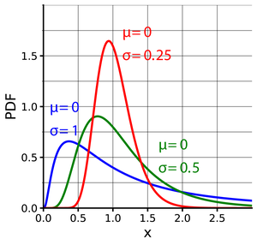


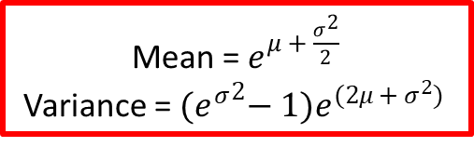

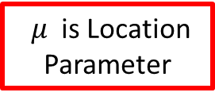

Hypothesis Problem under Parametric setup
Underlying Population distributions are Lognormal:
Independent populations
$$\text{X}\text{2} \sim Lognormal(μ_{2},σ_{2}^{2})$$
X$\sim Lognormal(μ_{1},σ_{1}^{2})$
$$\text{X}\text{3} \sim Lognormal(μ_{3},σ_{3}^{2})$$
Mean =${ e}^{μ + \frac{σ^{2}}{2}}$
Variance = ${{(e}^{σ}}^{2}−1)e^{(2μ + σ^{2}) }$
Population
X₁
Population
X₂
Population
X₃
$μ$ is Location Parameter
To test $H_{0}$: $μ_{1}=μ_{2}=μ_{3}$
Test for Equality
of Location Parameter
Against
To test $H_{0}$: $μ_{1}<μ_{2}<μ_{3}$
Chosen Alternative Hypothesis

Slide 15
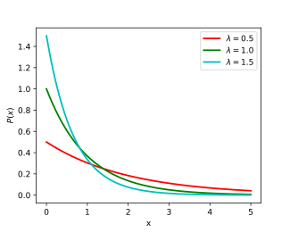





Hypothesis Problem under Parametric setup
Underlying Population distributions are Exponential:
Independent populations
$$\text{X}\text{3} \sim Exponential(μ_{3})$$
$$\text{X}\text{2} \sim Exponential(μ_{2})$$
X₁$\sim Exponential(μ_{1})$
Mean = $μ$
Variance = $μ^{2}$
Population
X₁
Population
X₂
Population
X₃
Mean is Scale Parameter
To test $H_{0}$: $μ_{1}=μ_{2}=μ_{3}$
Test for Equality
of Mean
Against
To test $H_{0}$: $μ_{1}<μ_{2}<μ_{3}$
Chosen Alternative Hypothesis

Slide 16
Parametric Test :
ONE – WAY ANOVA TEST

Slide 17

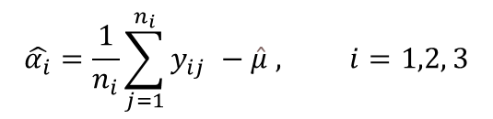





ONE – WAY ANOVA TEST
Response
Additional effect due to ith level of factor A
$$y_{ij}=μ_{i}+ε_{ij}=μ+α_{i}+ε_{ij }, where j=1\left(1\right)n_{i}, i=1, 2, 3$$
Model:
General Effect
Random Error
Simplified hypothesis :
$H_{0}$: $α_{1}=α_{2}=α_{3}=0$
against
$H_{1}$: $α_{1}<α_{2}<α_{3}$
Assumptions :
The responses $y_{ij} s, j=1\left(1\right)n_{i} and i = 1,2,3$are independent since the random samples are drawn independently from the three populations.
Assumption of Normality and Homoscedasticity
$ε_{ij} \sim N\left(0, σ^{2}\right) ∀ j=1\left(1\right)n_{i}, i=1,2, 3$
$$\sum_{i=1}^{3}{n_{i}α_{i}}=0$$
Constraint :
$$\hat{μ}=\overline{y_{00}}=\frac{1}{n}\sum_{i=1}^{3}{}$$
$$\sum_{j=1}^{n_{i}}{y_{ij}}$$
$$\hat{α_{i}}=\frac{1}{n_{i}}\sum_{j=1}^{n_{i}}{y_{ij} −\hat{μ} , i=1,2, 3}$$
Least Square Estimates
and

Slide 18
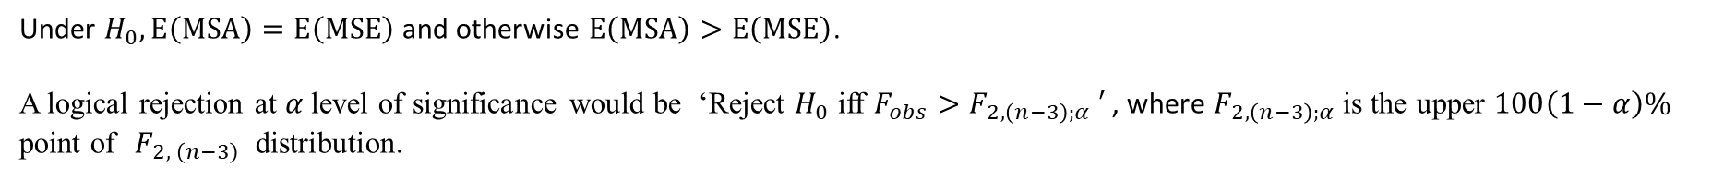
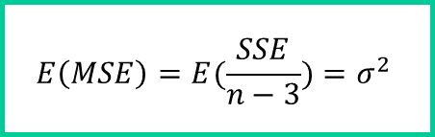
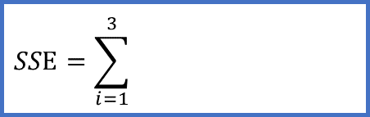
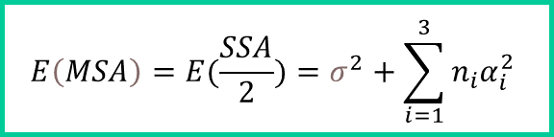

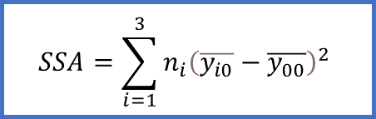

ONE – WAY ANOVA TEST
Partitioning of Total Sum square:
TSS = SSA + SSE
$$SSA=\sum_{i=1}^{3}{n_{i}{\left(\overline{y_{i0}}−\overline{y_{00}}\right)}^{2}}$$
$$E\left(MSA\right)=E(\frac{SSA}{2})=σ^{2}+\sum_{i=1}^{3}{n_{i}α_{i}^{2}}$$
$$SSE=\sum_{i=1}^{3}{}$$
$$E\left(MSE\right)=E(\frac{SSE}{n−3})=σ^{2}$$
$$\sum_{j=1}^{n_{i}}{{(y}_{ij}}−\overline{y_{i0}})^2$$
The One way ANOVA test statistic is defined as –
$F=\frac{MSA}{MSE}\sim F_{2, (n−3)}$ , under $H_{0}$
Under $H_{0}, E\left(MSA\right)=E\left(MSE\right)$ and otherwise $E\left(MSA\right)>E\left(MSE\right)$.
A logical rejection at $α$level of significance would be ‘Reject $H_{0}$ iff $F_{obs}>F_{2, \left(n−3\right);α} ′$, where $F_{2, \left(n−3\right);α}$is the upper $100\left(1−α\right)\%$ point of${ F}_{2, \left(n−3\right) }$distribution.

Slide 19
NONPARAMETRIC SETUP

Slide 20
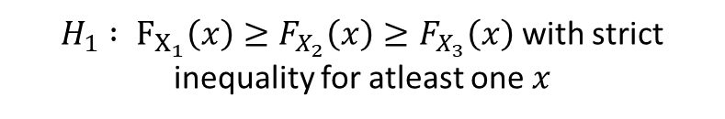


Equivalent Hypothesis under Non-Parametric setup
In non-parametric setup we generally write hypothesis in terms of CDF. Here, we will find the non-parametric equivalence of the testing problem $H_{0}$: : $μ_{1}=μ_{2}=μ_{3}$against $H_{1}$: $μ_{1}<μ_{2}<μ_{3}$
For example, if X₁$\sim Normal\left(μ_{1},σ_{1}^{2}\right), \text{X}\text{2} \sim Normal(μ_{2},σ_{2}^{2})$, $\text{X}\text{3} \sim Normal\left(μ_{3},σ_{3}^{2}\right)$with CDF’s $F_{X_{1}}, F_{X_{2}}, F_{X_{3}}$respectively, then –
Similarly, For
Laplace. Logistic, Lognormal, Exponential
$H_{0}$: $μ_{1}=μ_{2}=μ_{3}$
$$H_{0} : F_{X_{1}}\left(x\right)=F_{X_{2}}\left(x\right)=F_{X_{3}}\left(x\right) ∀x∈ℝ$$
Against
Against
$H_{1}$: $μ_{1}<μ_{2}<μ_{3}$
$H_{1} : F_{X_{1}}\left(x\right)≥F_{X_{2}}\left(x\right)≥F_{X_{3}}\left(x\right)$with strict inequality for atleast one $x$

Slide 21
Nonparametric Test :
KRUSKAL - WALLIS TEST

Slide 22




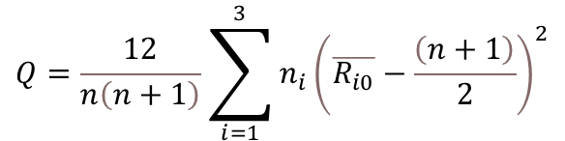

KRUSKAL - WALLIS TEST
Firstly, we combine the observations and order them in increasing manner that is from smallest to largest with keeping track of which observation is from which sample. We have $n=n_{1}+n_{2 }+n_{3}$ total observations. We assign the ranks 1,2,3,,...,n to the sequence.
$R_{ij}$ rank of the jth observation of the ith sample, i = 1,2,3 and j = 1,2,...,ni
Rank Sum
of ith sample
$$R_{i}=\sum_{i=1}^{3}{R_{ij}}$$
Mean Rank of ith sample
$$\overline{R_{i0}}=\frac{R_{i}}{n_{i}}$$
The Kruskal-Wallis test statistic is defined as –
$$Q=\frac{12}{n\left(n+1\right)}\sum_{i=1}^{3}{n_{i}{\left(\overline{R_{i0}}−\frac{\left(n+1\right)}{2}\right)}^{2}}$$
$α$ is chosen level of significance
A logical rejection would be ‘Reject $H_{0}$ iff $Q >c_{α}′ , where$ $c_{α}$ is so chosen that- $Pr\left(Q> c_{α } | H_{0}\right)≤ α$.
Using Central Limit Theorem, it can be shown that for large $n_{1},n_{2}, n_{3}$, under $H_{0}$ approximately -
$$Q=\sum_{i=1}^{3}{\frac{n−n_{i}}{n}z_{i}^{2}}\sim χ_{2}^{2}$$
Asymptotic Distribution
$$z_{i}=\frac{\overline{R_{i0}}−\frac{n+1}{2}}{\sqrt{\frac{\left(n+1\right)\left(n−nⅈ\right)}{12n_{i}}}}$$
where,
Under large sample approximation we would, ‘Reject $H_{0}$ iff $Q >χ_{2 ; α}^{2}′$

Slide 23

Simulations, empirical powers, sizes and Observations

Slide 24


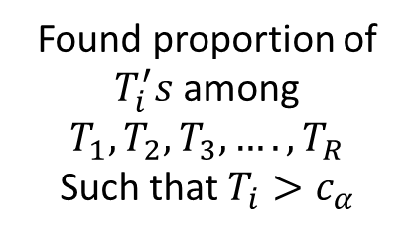

Simulation and Its use in our study
By Simulation statisticians mean “Monte Carlo Simulation”. It is a computer experiment involving random sampling from probability distributions.
In this article we have used simulation to find empirical size & power of the tests discussed before under different population distributions.
Generated R values of test statistic
$T_{1}, T_{2}, T_{3}, …., T_{R}$
Found proportion of
$T_{i}^{′}s$among $T_{1}, T_{2}, T_{3}, …., T_{R}$
Such that $T_{i}>c_{α}$
Gives empirical power and size for suitably chosen values of parameters
R = Number of Times to Replicate
$c_{α}$ = Critical Value

Slide 25


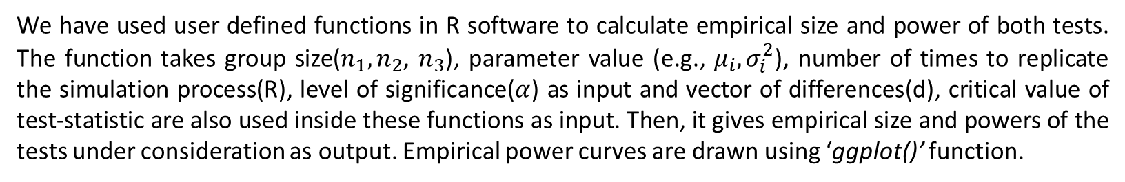
Overall Introduction
We have used user defined functions in R software to calculate empirical size and power of both tests. The function takes group size($n_{1},n_{2}$, $n_{3}$), parameter value (e.g., $μ_{i}, σ_{i}^{2}$), number of times to replicate the simulation process(R), level of significance($α$) as input and vector of differences(d), critical value of test-statistic are also used inside these functions as input. Then, it gives empirical size and powers of the tests under consideration as output. Empirical power curves are drawn using ‘ggplot()’ function.
Sample Size
Number of Times to Replicate
R = 2000
input
User Defined Function
input
Parameter Value
Level of Significance
$α=$0.05, 0.1
Vector of Differences
Critical Value
output
Empirical Power and Size

Slide 26

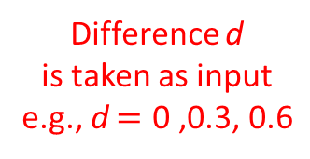



Empirical Power Curve
For empirical power curves we have plotted the difference(d) between population X₁ mean$\left(μ_{1}\right)$ and population X₂ mean($μ_{2}$) on the X axis (also $d=μ_{3}−μ_{2}$) and empirical size and power on the Y axis. We have kept population X₁ mean fixed and varied mean of population X₂ and X₃ ($μ_{3}$) according to our alternative hypothesis of interest.
Population X₂ Mean
Population X₃ Mean
For example -
Population X₁ Mean
$μ_{1}= μ_{0}$
$μ_{2}= μ_{1}+d$
$=μ_{0}+d$
$μ_{3}= μ_{2}+d$
$=μ_{0}+2d$
Difference d
is taken as input
e.g., d $=\text{0} \text{,0.3,} \text{0.6}$
Taken as Input
e.g., $μ_{0}=1, 5$

Slide 27
Simulation-1: Comparison of Empirical Size and Power of One-way ANOVA and Kruskal Test When Underlying Population Distribution is Normal . . . . . 34
Simulation: 1
Simultaneous Comparison of Empirical Size and Power of One-way ANOVA and Kruskal Wallis Test When Underlying Population Distribution is Normal

Slide 28
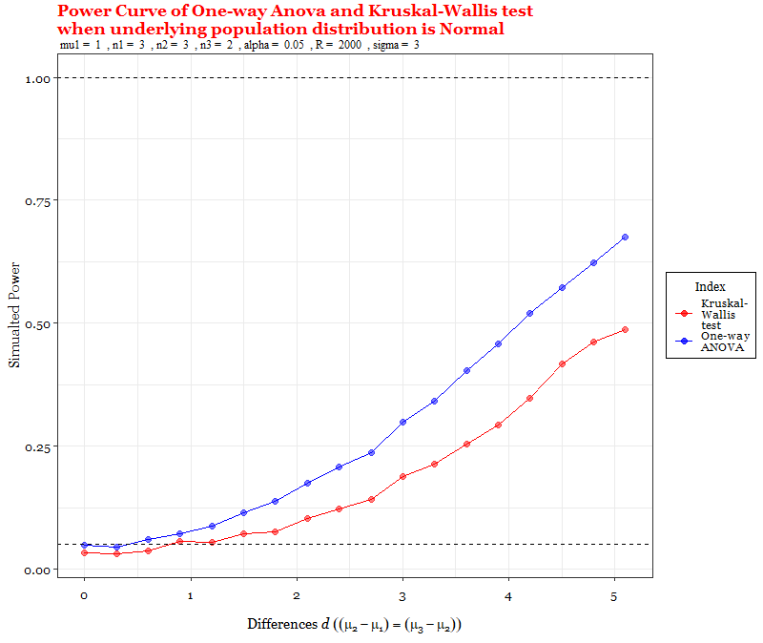
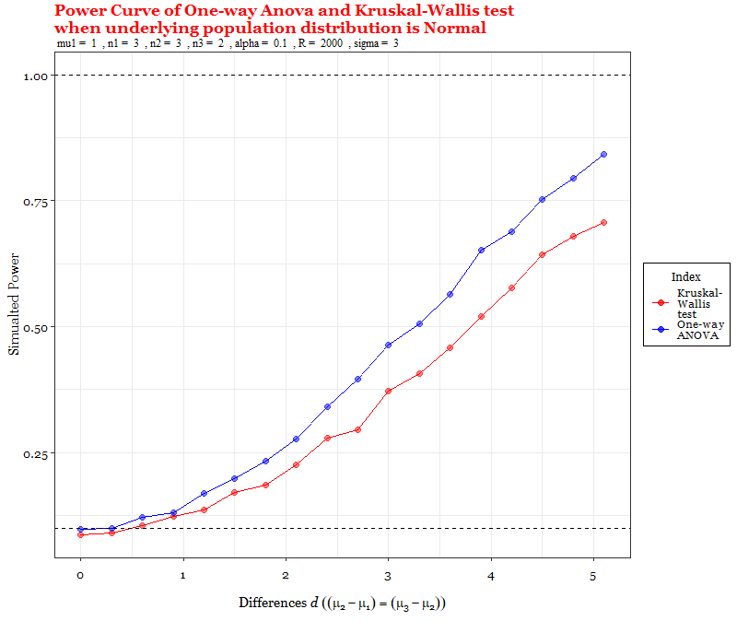

whe
Mean of population X₁, i.e., $μ_{1}$is fixed at 1, sample sizes are $n_{1}=3, n_{2}=3, n_{3}=2$ and $σ^{2}=3^{2}$
α = 0.05
$$α=0.05$$
α = 0.1

Slide 29


whe
Mean of population X₁, i.e., $μ_{1}$is fixed at 5, sample sizes are $n_{1}=3, n_{2}=3, n_{3}=2$ and $σ^{2}=3^{2}$
α = 0.05
$$α=0.05$$
α = 0.1

Slide 30
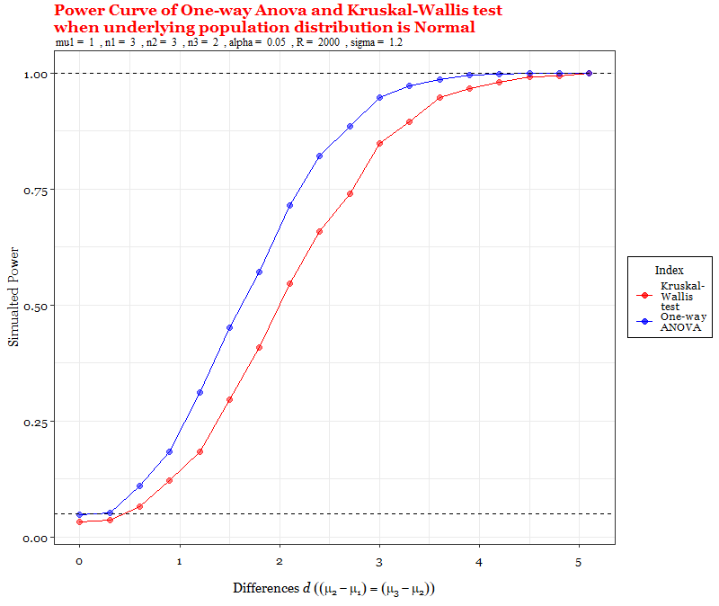
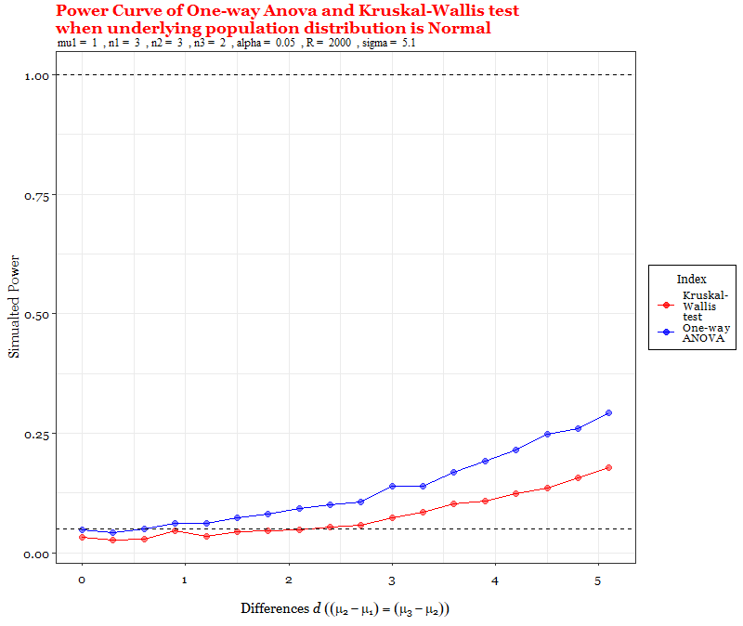



whe
Mean of population X₁, i.e., $μ_{1}$is fixed at 1, sample sizes are $n_{1}=3, n_{2}=3, n_{3}=2$ and α = 0.05
Similar thing will happen for
$$α=0.1$$
$$σ^{2}= {1.2}^{2}$$
$$σ^{2}= {5.1}^{2}$$

Slide 31
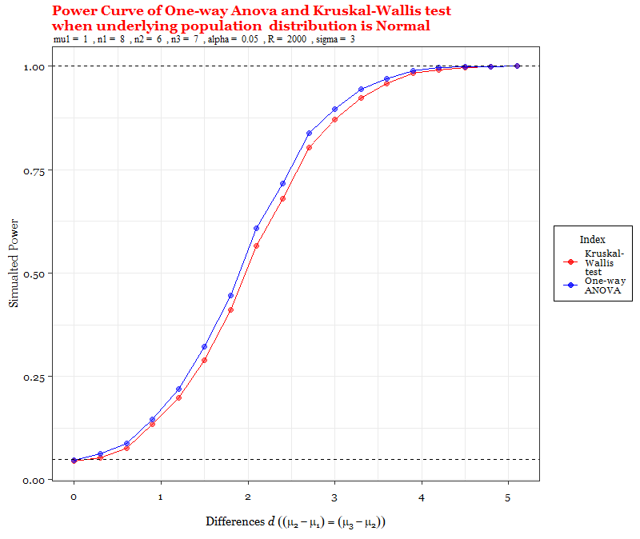
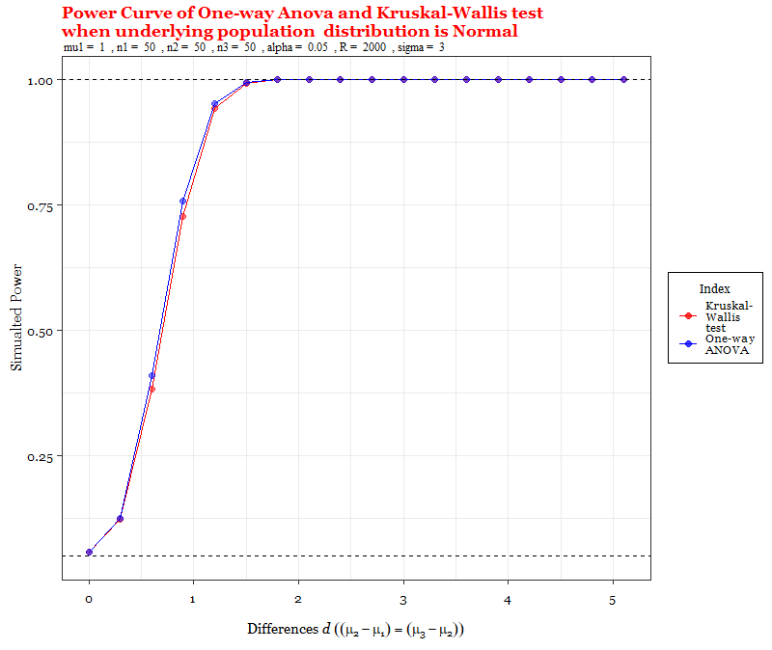





whe
Both One-Way ANOVA test and Kruskal-Wallis Test are consistent
Mean of population X₁, i.e., $μ_{1}$is fixed at 1, $σ^{2}=3^{2}$ and α = 0.05
$$n_{1}=3, n_{2}=3, n_{3}=2$$
$$n_{1}=8, n_{2}=6, n_{3}=7$$
$$n_{1}=50, n_{2}=50, n_{3}=50$$
Group Sizes increase and hence total sample size increases
Similar thing will happen for
$$α=0.1$$

Slide 32
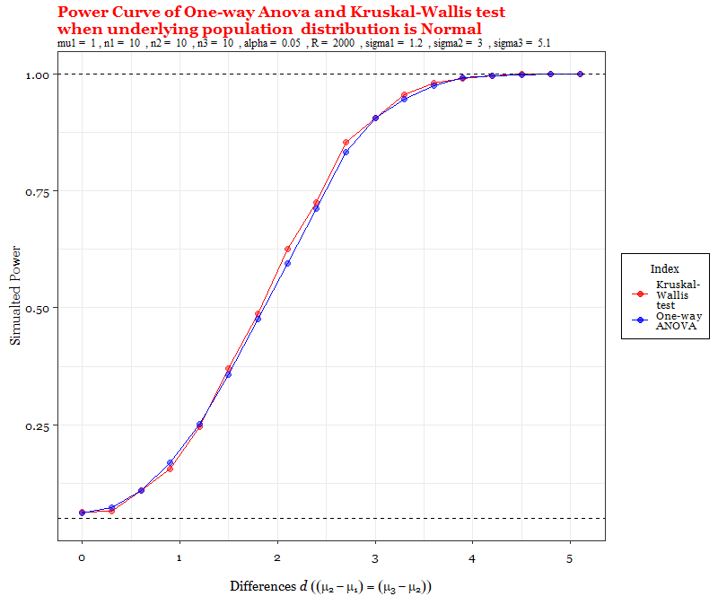
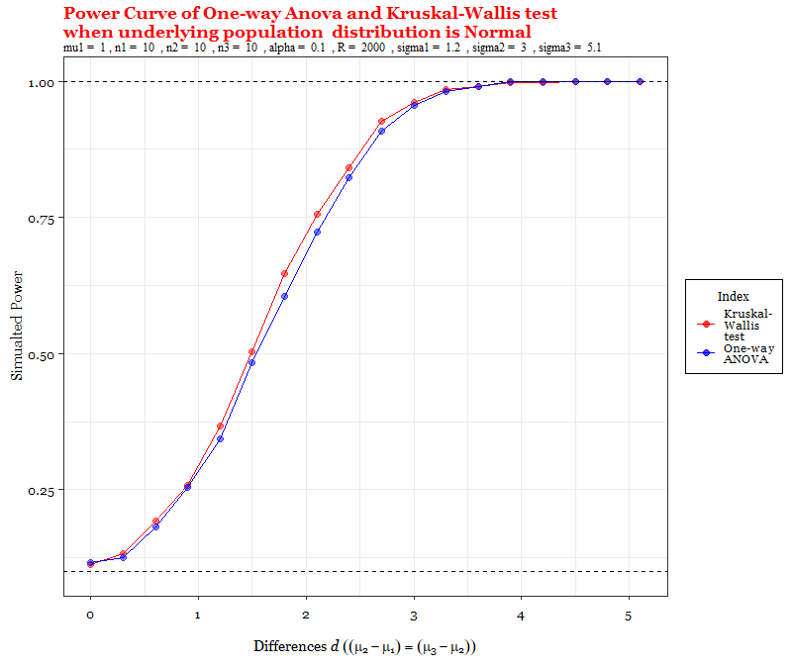
whe
Under Heteroscedasticity
Mean of population X₁, i.e., $μ_{1}$is fixed at 1, sample sizes are $n_{1}=10, n_{2}=10, n_{3}=10$ and for population X_{1,} X_{2,} X₃ respectively let $σ_{1}^{2 }= {1.2}^{2} , σ_{2}^{2}= 3^{2}, σ_{3}^{2}= {5.1}^{2}$
α = 0.05
α = 0.1

Slide 33
Simulation-1: Comparison of Empirical Size and Power of One-way ANOVA and Kruskal Test When Underlying Population Distribution is Normal . . . . . 34
Simulation: 2
Simultaneous Comparison of Empirical Size and Power of One-way ANOVA and Kruskal Wallis Test When Underlying Population Distribution is Laplace

Slide 34
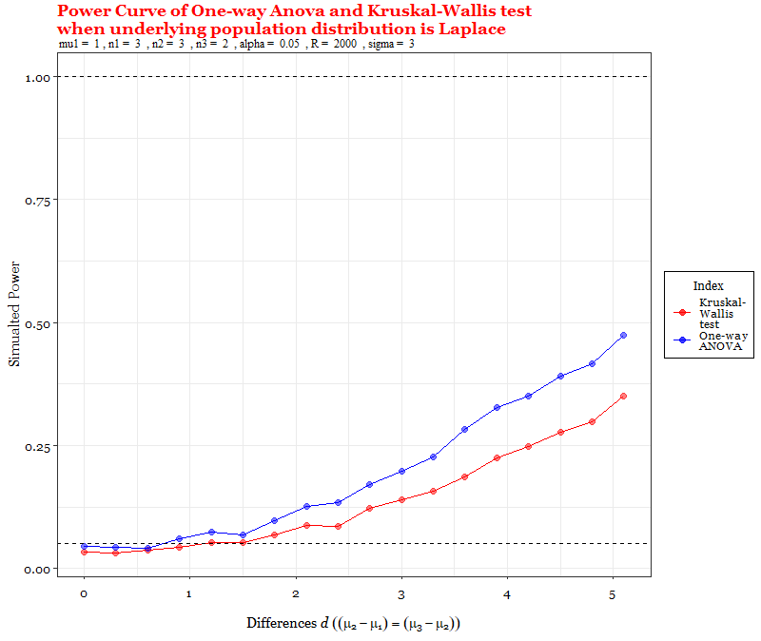
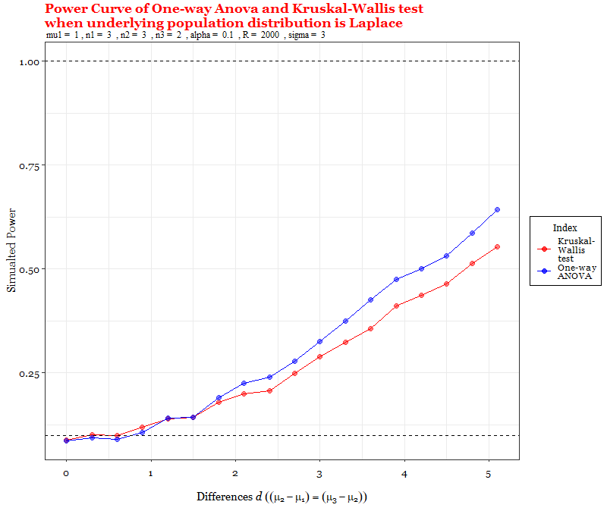
whe
Mean of population X₁, i.e., $μ_{1}$is fixed at 1, sample sizes are $n_{1}=3, n_{2}=3, n_{3}=2$ and $σ^{2}=3^{2}$
α = 0.05
$$α=0.05$$
α = 0.1

Slide 35


whe
Mean of population X₁, i.e., $μ_{1}$is fixed at 5, sample sizes are $n_{1}=3, n_{2}=3, n_{3}=2$ and $σ^{2}=3^{2}$
α = 0.05
$$α=0.05$$
α = 0.1

Slide 36
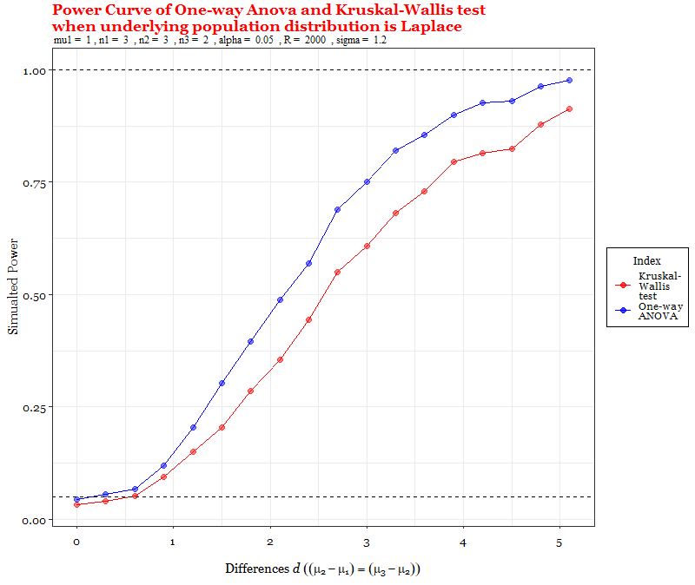




whe
Mean of population X₁, i.e., $μ_{1}$is fixed at 1, sample sizes are $n_{1}=3, n_{2}=3, n_{3}=2$ and α = 0.05
Similar thing will happen for
$$α=0.1$$
$$σ^{2}= {1.2}^{2}$$
$$σ^{2}= {5.1}^{2}$$

Slide 37

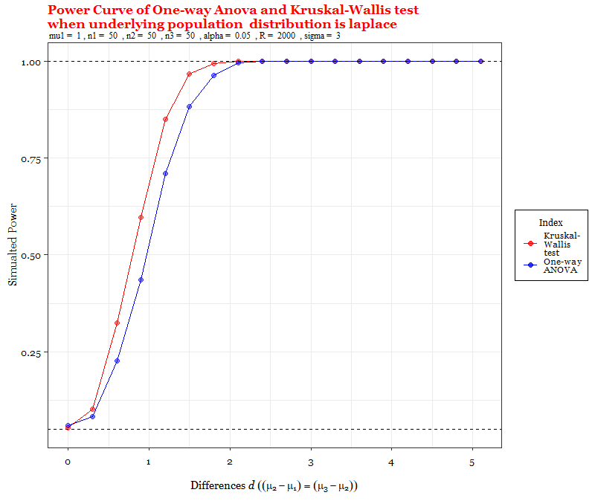

whe
Both One-Way ANOVA test and Kruskal-Wallis Test are consistent
Mean of population X₁, i.e., $μ_{1}$is fixed at 1, $σ^{2}=3^{2}$ and α = 0.05
$$n_{1}=3, n_{2}=3, n_{3}=2$$
$$n_{1}=8, n_{2}=6, n_{3}=7$$
$$n_{1}=50, n_{2}=50, n_{3}=50$$
Group Sizes increase and hence total sample size increases
Similar thing will happen for
$$α=0.1$$

Slide 38
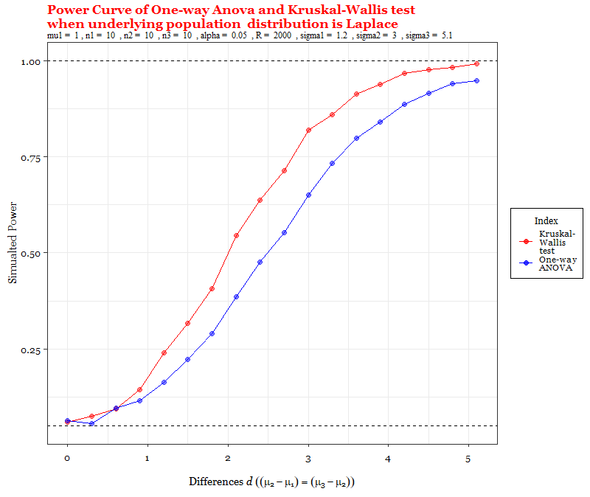
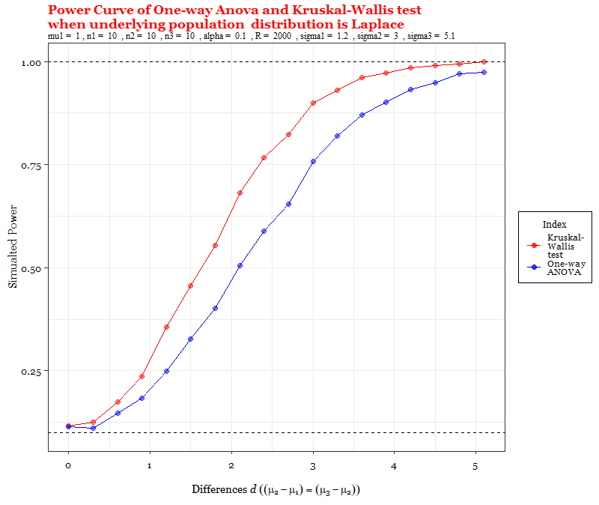
whe
Under Heteroscedasticity
Mean of population X₁, i.e., $μ_{1}$is fixed at 1, sample sizes are $n_{1}=10, n_{2}=10, n_{3}=10$ and for population X_{1,} X_{2,} X₃ respectively let $σ_{1}^{2 }= {1.2}^{2} , σ_{2}^{2}= 3^{2}, σ_{3}^{2}= {5.1}^{2}$
α = 0.05
α = 0.1

Slide 39
Simulation-1: Comparison of Empirical Size and Power of One-way ANOVA and Kruskal Test When Underlying Population Distribution is Normal . . . . . 34
Simulation: 3
Simultaneous Comparison of Empirical Size and Power of One-way ANOVA and Kruskal Wallis Test When Underlying Population Distribution is Logistic

Slide 40


whe
Mean of population X₁, i.e., $μ_{1}$is fixed at 1, sample sizes are $n_{1}=3, n_{2}=3, n_{3}=2$ and $σ^{2}=3^{2}$
α = 0.05
$$α=0.05$$
α = 0.1

Slide 41


whe
Mean of population X₁, i.e., $μ_{1}$is fixed at 5, sample sizes are $n_{1}=3, n_{2}=3, n_{3}=2$ and $σ^{2}=3^{2}$
α = 0.05
$$α=0.05$$
α = 0.1

Slide 42


whe
Mean of population X₁, i.e., $μ_{1}$is fixed at 1, sample sizes are $n_{1}=3, n_{2}=3, n_{3}=2$ and α = 0.05
Similar thing will happen for
$$α=0.1$$
$$σ^{2}= {1.2}^{2}$$
$$σ^{2}= {5.1}^{2}$$

Slide 43


whe
Both One-Way ANOVA test and Kruskal-Wallis Test are consistent
Mean of population X₁, i.e., $μ_{1}$is fixed at 1, $σ^{2}=3^{2}$ and α = 0.05
$$n_{1}=3, n_{2}=3, n_{3}=2$$
$$n_{1}=8, n_{2}=6, n_{3}=7$$
$$n_{1}=50, n_{2}=50, n_{3}=50$$
Group Sizes increase and hence total sample size increases
Similar thing will happen for
$$α=0.1$$

Slide 44


whe
Under Heteroscedasticity
Mean of population X₁, i.e., $μ_{1}$is fixed at 1, sample sizes are $n_{1}=10, n_{2}=10, n_{3}=10$ and for population X_{1,} X_{2,} X₃ respectively let $σ_{1}^{2 }= {1.2}^{2} , σ_{2}^{2}= 3^{2}, σ_{3}^{2}= {5.1}^{2}$
α = 0.05
α = 0.1

Slide 45
Simulation-1: Comparison of Empirical Size and Power of One-way ANOVA and Kruskal Test When Underlying Population Distribution is Normal . . . . . 34
Simulation: 4
Simultaneous Comparison of Empirical Size and Power of One-way ANOVA and Kruskal Wallis Test When Underlying Population Distribution is Lognormal

Slide 46


whe
Mean of population X₁, i.e., $μ_{1}$is fixed at 1, sample sizes are $n_{1}=3, n_{2}=3, n_{3}=2$ and $σ^{2}=3^{2}$
α = 0.05
$$α=0.05$$
α = 0.1

Slide 47


whe
Mean of population X₁, i.e., $μ_{1}$is fixed at 5, sample sizes are $n_{1}=3, n_{2}=3, n_{3}=2$ and $σ^{2}=3^{2}$
α = 0.05
$$α=0.05$$
α = 0.1

Slide 48


whe
Mean of population X₁, i.e., $μ_{1}$is fixed at 1, sample sizes are $n_{1}=3, n_{2}=3, n_{3}=2$ and α = 0.05
Similar thing will happen for
$$α=0.1$$
$$σ^{2}= {1.2}^{2}$$
$$σ^{2}= {5.1}^{2}$$

Slide 49



whe
One-Way ANOVA test is not consistent, but Kruskal-Wallis Test is consistent
Mean of population X₁, i.e., $μ_{1}$is fixed at 1, $σ^{2}=3^{2}$ and α = 0.05
$$n_{1}=3, n_{2}=3, n_{3}=2$$
$$n_{1}=8, n_{2}=6, n_{3}=7$$
$$n_{1}=50, n_{2}=50, n_{3}=50$$
Group Sizes increase and hence total sample size increases
Similar thing will happen for
$$α=0.1$$

Slide 50
$$X \sim Lognormal(μ, σ^{2})$$
𝑿 ~ 𝑳𝒐𝒈𝒏𝒐𝒓𝒎𝒂𝒍(𝝁, 𝝈^𝟐)
$$V\left(X\right)={{(e}^{σ}}^{2}−1)e^{(2μ + σ^{2}) }$$
No need to check separately under heteroscedasticity
𝑽(𝑿)=〖〖(𝒆〗^𝝈〗^𝟐−𝟏)𝒆^((𝟐𝝁 + 𝝈^𝟐) )
No need to check separately under heteroscedasticity

Slide 51
Simulation-1: Comparison of Empirical Size and Power of One-way ANOVA and Kruskal Test When Underlying Population Distribution is Normal . . . . . 34
Simulation: 5
Simultaneous Comparison of Empirical Size and Power of One-way ANOVA and Kruskal Wallis Test When Underlying Population Distribution is Exponential

Slide 52


whe
Mean of population X₁, i.e., $μ_{1}$is fixed at 1, sample sizes are $n_{1}=3, n_{2}=3, n_{3}=2$
α = 0.05
$$α=0.05$$
α = 0.1

Slide 53



whe
Mean of population X₁, i.e., $μ_{1}$is fixed at 5, sample sizes are $n_{1}=3, n_{2}=3, n_{3}=2$
α = 0.05
$$α=0.05$$
Power changes due to change in $μ_{1}!$
α = 0.1

Slide 54



whe
Both One-Way ANOVA test and Kruskal-Wallis Test are consistent
Mean of population X₁, i.e., $μ_{1}$is fixed at 1 and α = 0.05
$$n_{1}=3, n_{2}=3, n_{3}=2$$
$$n_{1}=8, n_{2}=6, n_{3}=7$$
$$n_{1}=50, n_{2}=50, n_{3}=50$$
Group Sizes increase and hence total sample size increases
Similar thing will happen for
$$α=0.1$$

Slide 55
$$X \sim Exponential(μ)$$
𝑿 ~ 𝑬𝒙𝒑𝒐𝒏𝒆𝒏𝒕𝒊𝒂𝒍(𝝁)
$$V\left(X\right)=μ^{2}$$
No need to check separately under heteroscedasticity
𝑽(𝑿)=𝝁^𝟐
No need to check separately under heteroscedasticity
$σ^{2}$ is not a parameter
𝝈^𝟐 is not a parameter

Slide 56

Some Observations
Under normal distribution, one-way ANOVA is the uniformly most powerful test. Even under heteroscedasticity power of ANOVA is not much affected but still we see that Kruskal-Wallis test is slightly better than ANOVA for normal distribution under heteroscedasticity.
Under logistic distribution, ANOVA has more power than Kruskal Wallis test for large group sizes whereas under laplace distribution, as sample size increases, power of Kruskal Wallis test increases.
For lognormal distribution, Kruskal Wallis test has more power than ANOVA in every considered situations. Also, ANOVA is not a consistent test for testing equality of means under here. Again, under exponential distribution we see that Kruskal Wallis test has more power than ANOVA moderately large group sizes. And for small group sizes and small values of $μ_{i}$s ANOVA performs better than Kruskal Wallis when α = 0.05 but we see the opposite picture under same condition for α = 0.1. This is may be happening because for lognormal and exponential not only the assumption of normality is violated but also the assumption of homoscedasticity is also violated automatically.
From the empirical power curves we see that as when underlying population distribution is normal, power increases more rapidly than under laplace, logistic, lognormal, exponential.
For normal, laplace, logistic and lognormal, value of empirical power doesn’t depend on $μ_{i}s$ but depends on $σ_{i}^{2}s$whereas for exponential, empirical power depends on $μ_{i}$ s.
From the empirical power curves, The values of empirical power for both tests are slightly higher for higher values of level of significance (α) under every distributions.

Slide 57
Conclusion
From the above analysis of empirical size and power of parametric test one-way ANOVA and non-parametric test Kruskal-Wallis test for testing equality of means of three independent populations, we see that,
Under normal distribution, one-way ANOVA is the uniformly most powerful test. Even under heteroscedasticity power of ANOVA is not much affected but still we see that Kruskal-Wallis test is slightly better than ANOVA for normal distribution under heteroscedasticity.
In general, for non-normal symmetric distribution like laplace, logistic, we see still one-way ANOVA is performing better than Kruskal Wallis test under homoscedasticity and moderate group sizes but if the assumption of homoscedasticity is also violated and for large group sizes, Kruskal Wallis test has more power than ANOVA.
In general, Kruskal-Wallis test performs better than ANOVA for non-normal asymmetric distribution like lognormal, exponential.

Slide 58

References
Mood, Alexander McFarlane, Graybill, Franklin A. and Boes, Duane C., Introduction to the theory of statistics, McGraw-Hill, New York, 1963.
Jean D. Gibbons and Subhabrata Chakraborti, $Nonparametric Statistical Inference$, Chapman and Hall/CRC, New York, 6th Edition, December 22, 2020.
T. Van Heke, $Power study of anova versus Kruskal−Wallis test,$Journal of statistics and Management Systems, December 16, 2016.
Felix N. Nwobi and Felix C. Akanno, Power comparison of ANOVA and Kruskal-Wallis tests When error assumptions are violated$,$Journal of Advances in methodology and Statistics, June 13, 2021.

Slide 59

Acknowledgement
I would like to acknowledge and give my warmest thanks to my supervisor Prof. Pallabi Ghosh who made this work possible. Her proper guidance and advice carried me through all the stages of writing my project. I have learned so many things under her guidance.
Also, I would like to thank all my other respected Professors of Department of Statistics in St. Xavier’s College (Autonomous), Kolkata, Prof. Dr. Surabhi Dasgupta, Prof. Dr. Surupa Chakrabarty, Prof. Dr. Ayan Chandra, Prof. Dr. Durba Bhattacharya, Prof. Debjit Sengupta, Prof. Madhura Dasgupta, Prof. Dr. Sanchari Basak.
Thank You !!

